Slide 1
Uncertainty Quantification for Cyber-Physical PWR Experiments
Taylor K. McKenzie (PI)
Team: Ray Fasano, Ryan Kao, Tim Ortiz, Christopher Lamb, Thomas D. Tarman
Notes:
Hello and thank you for listening. I’m Taylor McKenzie and I’ll be talking about our work on performing uncertainty quantification for cyber-physical PWR experiments.

Slide 2
Introduction
Ph.D. in Economics from University of Oregon in 2017
Joined Sandia National Laboratories in 2017 into Cyber Resilience R&D group
Within group: Developed metrics to assess resilience of cyber-physical systems, performed statistical analyses on cyber emulation experiments, performed risk/resilience/red team studies for specific cyber systems/applications
Matrixing: Interagency Nuclear Safety Review Board/Mars 2020, analyses of economic impact of natural disasters and radiological attacks, risk/reliability analyses of specific (non-cyber) systems
Joined Sandia’s Strategic Futures and Policy Analysis group in March 2020
Conducting and informing mission-enabling policy studies: Telecommuting/hybrid work posture, COVID-19 impacts, chip manufacturing facility cyber risk study
Conducting and informing policy studies: Space infrastructure study (Air Force Office of Scientific Research), public perceptions of nuclear weapons and deterrence (Institute for Public Policy Research and Analysis)
Leading and contributing to studies in Sandia’s Global Futures series: Space Futures, Future of Collective Security, Future of Economic Value and National Security (lead), Future R&D Ecosystems, Future of Arms Control, Future of Knowledge Management (lead)

Slide 3
Agenda
Uncertainty quantification for cyber-physical pressurized water reactor experiments (McKenzie et al. 2020)
Introduce and motivate experiments on cyber-physical nuclear power generation systems
Overview of uncertainty quantification and comparison with statistics
Gaussian processes for uncertainty quantification
Specific application and results
Follow-on work and extensions
Gaussian processes in other applications
The inverse problem
Applying the inverse problem to Interagency Nuclear Safety Review Board analyses

Slide 4
Background
Sandia has significant capabilities in cyber-physical emulation platforms/frameworks
The SCEPTRE platform was developed to “analyze how cyber-initiated events affect the physical world,” using a network emulation with hardware-in-the-loop capabilities to model, test, and validate cyber-physical systems [1]
These capabilities have been used to assess risk and resilience of a range of cyber-physical systems to natural and adversarial disruptions. Systems studied include critical infrastructures (e.g., power, gas, chemical), space/satellite systems, purpose-built ICS.
This project was funded by sponsors from DOE-NE, who were interested in the risk posed to cyber-physical nuclear power generation
Specifically interested in metrics to evaluate risk of catastrophic outcomes given a particular attack scenario
Cyber-physical emulation is particularly well-suited for this analysis
Nuclear reactor mechanics/dynamics are well understood and high-fidelity simulation models exist for these systems
Cyber systems/components are less well-understood and more difficult to simulate with needed fidelity, so those components are emulated

Slide 5
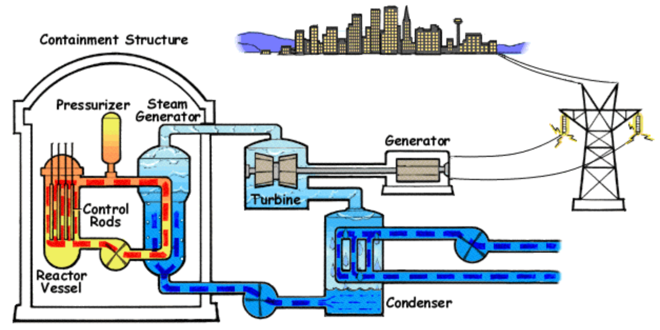
Proof of Concept System: Pressurized Water Reactor
Image sources: NRC, Wikipedia

Slide 6
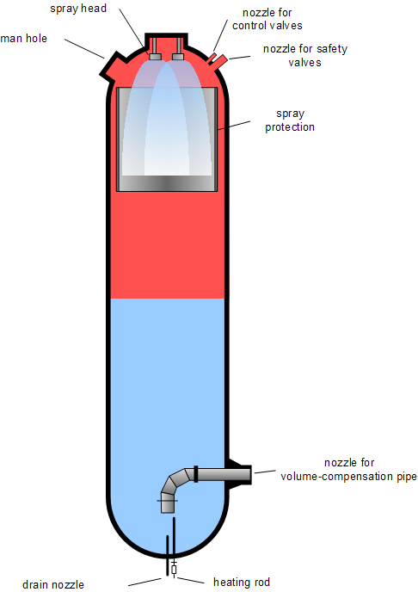
Proof of Concept System: Pressurized Water Reactor
Image sources: NRC, Wikipedia

Slide 7
Proof of Concept System: Pressurized Water Reactor
Pressurized water reactors (PWRs) are a nuclear reactor design with the following characteristics:
Two coolant loops:
Primary loop where coolant cools and moderates the reactor
Secondary loop where coolant is heated by the primary and generates steam that drives turbines
Pressurized primary reactor loop, which allows coolant to reach high temperatures while remaining liquid
Typical pressure: ~15-16 MPa
Typical temperature: ~345 °C
In a dual coolant loop design, only coolant in the primary loop requires significant radioactive containment
Pressurizer sits on the primary coolant loop and maintains appropriate pressure
Too high could damage vessels/pipes/components. Too low could allow water to flash to steam.
Electric heaters increase temperature/pressure of pressurizer, water sprayers reduce temperature/pressure
Pressurizer is a critical component of the system, and failures are highly consequential

Slide 8
Research Problem
Previous risk/resilience analyses, red team assessments, and intelligence can be used to form a distribution of adversarial attacks
For this analysis, attacks will continually inject a specified control value to the pressurizer heater and/or sprayer. The injected values and which component(s) are targeted is assumed to be random.
Given a distribution of attacks, our goal is to estimate the probability that a catastrophic outcome will occur
Severe consequences can occur if differential pressure on the pressurizer exceeds 1 MPa
Emulation models for generic PWR systems were developed for previous projects. Those could be used to estimate failure probability using Monte Carlo methods.
However, emulation is computationally expensive, making it infeasible to estimate probability of failure probability with acceptable level of uncertainty
Need to use methods that can accommodate limited numbers of observations and correctly express uncertainty
Uncertainty quantification (UQ) methods can be used to estimate outcomes and evaluate uncertainty in those estimates when obtaining additional observations is expensive

Slide 9
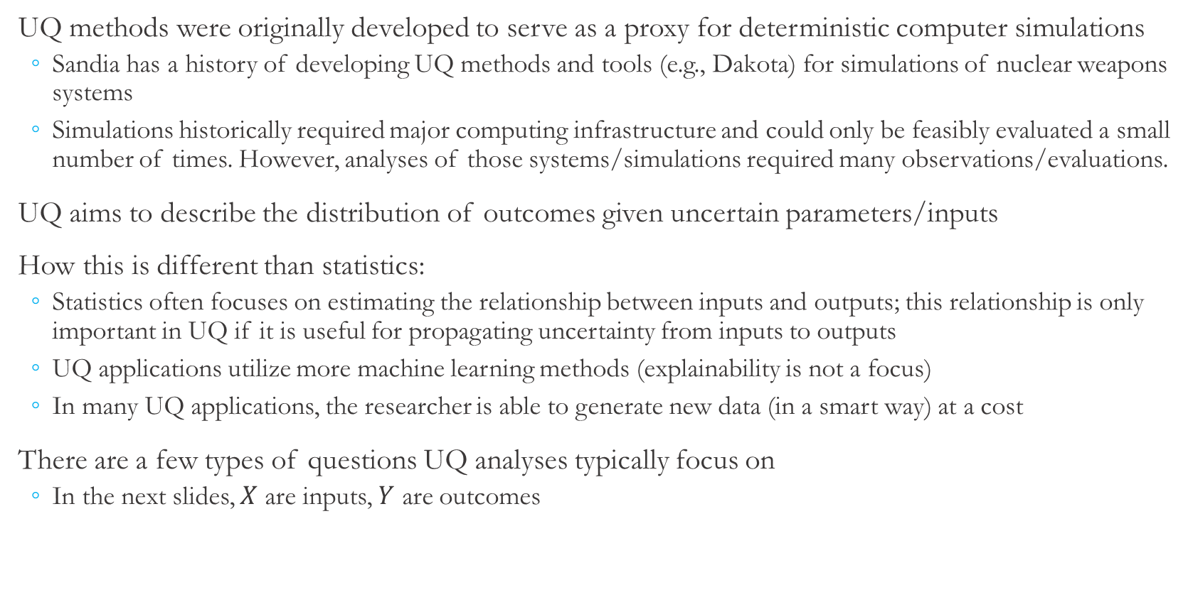
UQ vs. Statistics
UQ methods were originally developed to serve as a proxy for deterministic computer simulations
Sandia has a history of developing UQ methods and tools (e.g., Dakota) for simulations of nuclear weapons systems
Simulations historically required major computing infrastructure and could only be feasibly evaluated a small number of times. However, analyses of those systems/simulations required many observations/evaluations.
UQ aims to describe the distribution of outcomes given uncertain parameters/inputs
How this is different than statistics:
Statistics often focuses on estimating the relationship between inputs and outputs; this relationship is only important in UQ if it is useful for propagating uncertainty from inputs to outputs
UQ applications utilize more machine learning methods (explainability is not a focus)
In many UQ applications, the researcher is able to generate new data (in a smart way) at a cost
There are a few types of questions UQ analyses typically focus on
In the next slides, $X$ are inputs, $Y$ are outcomes

Slide 10
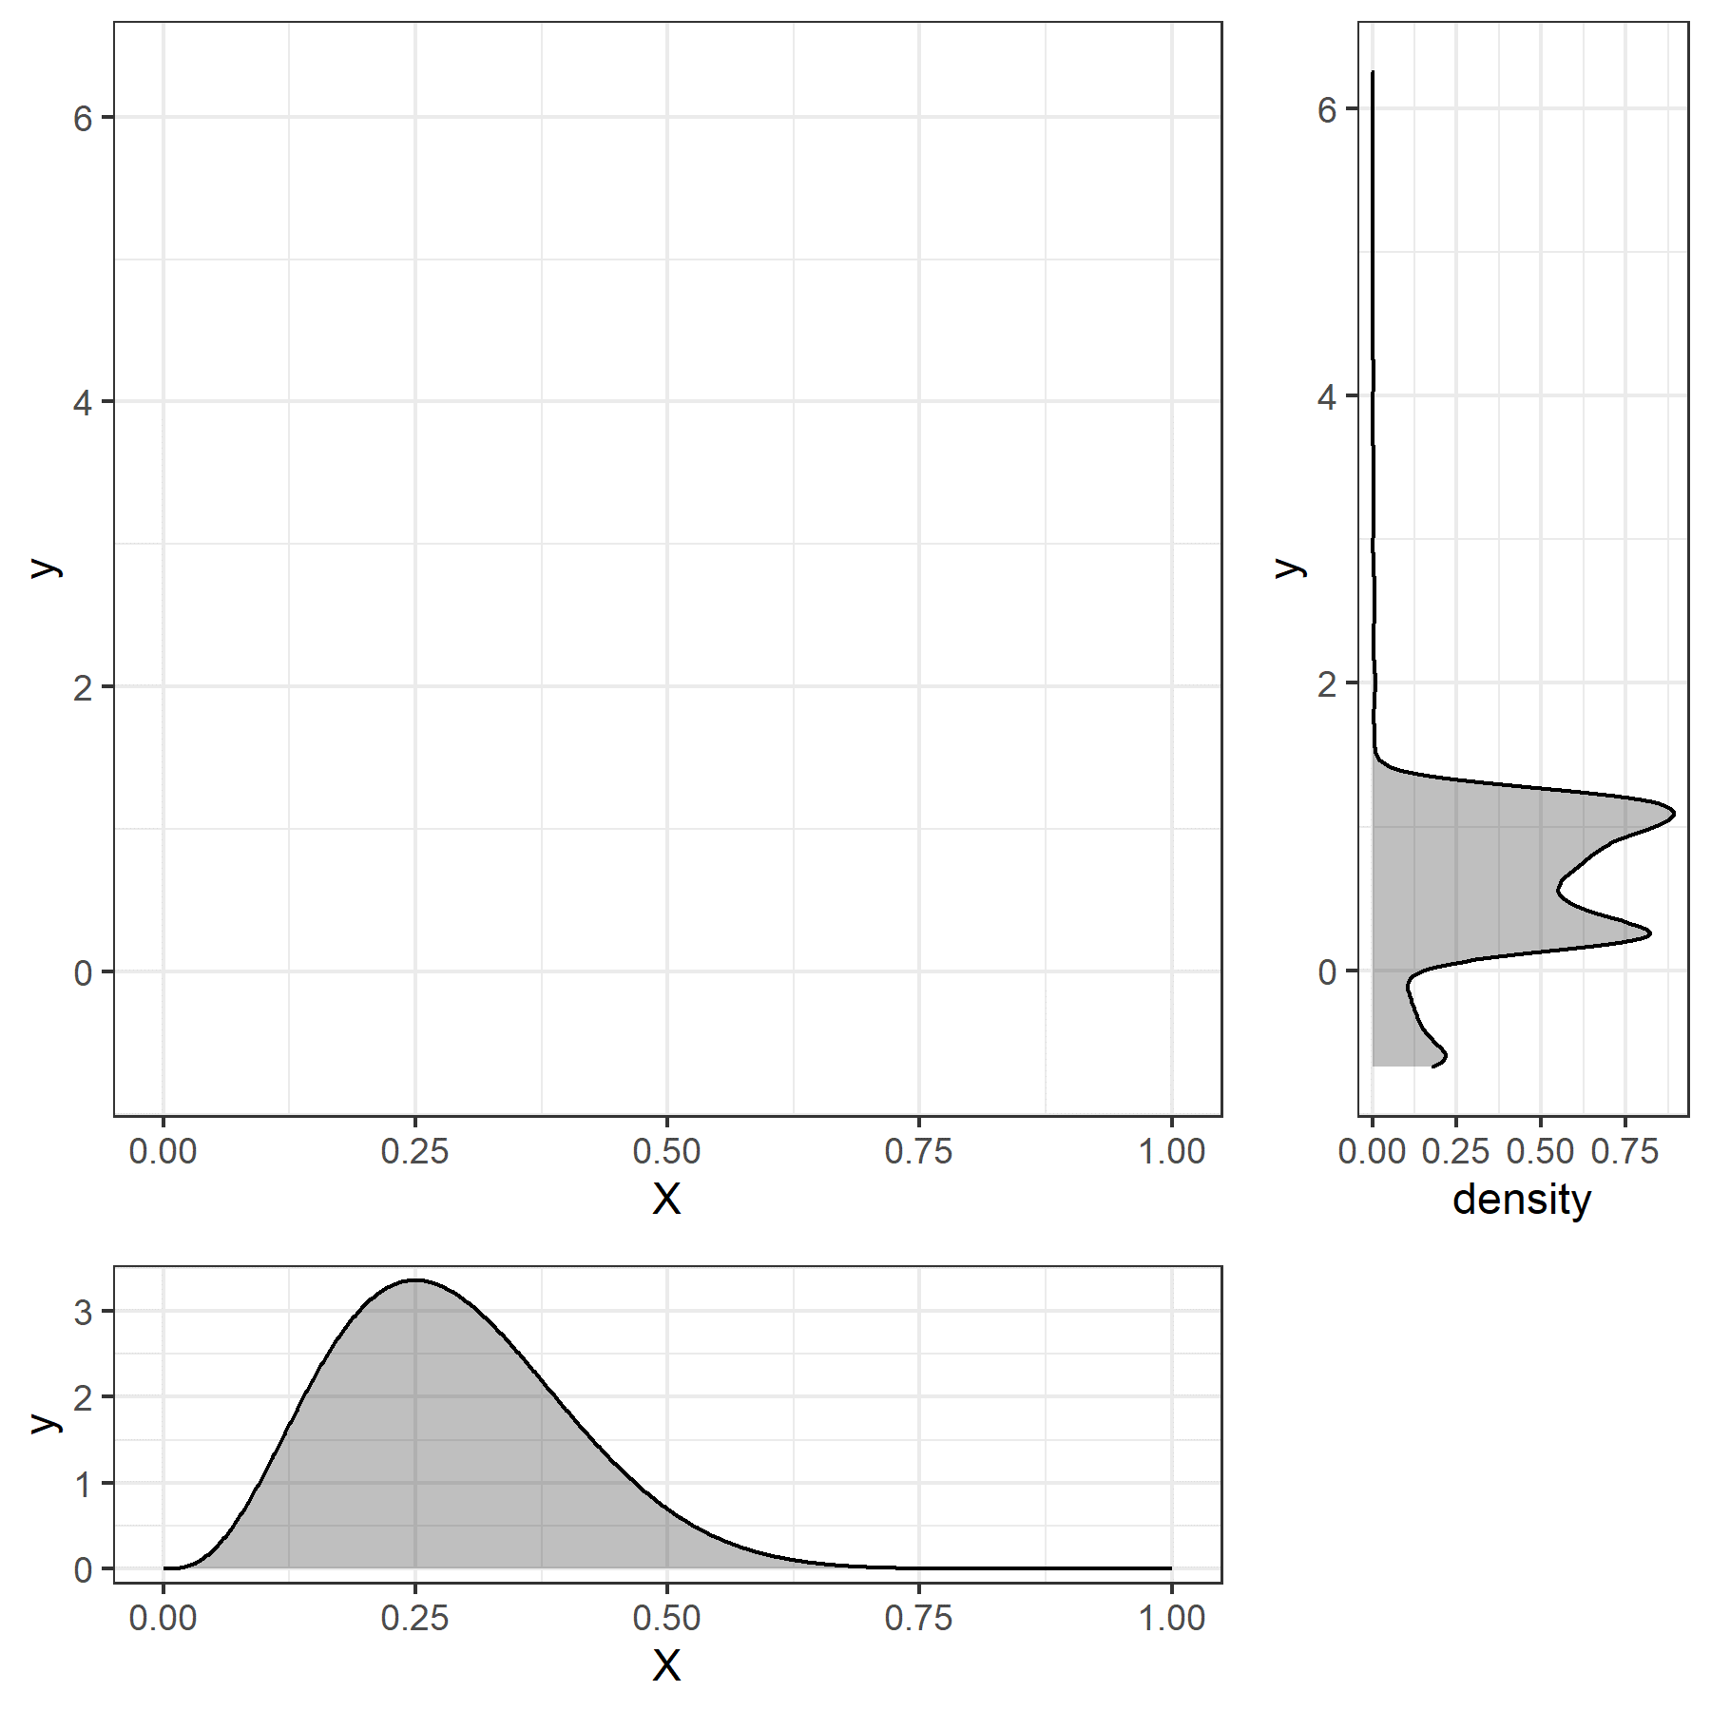
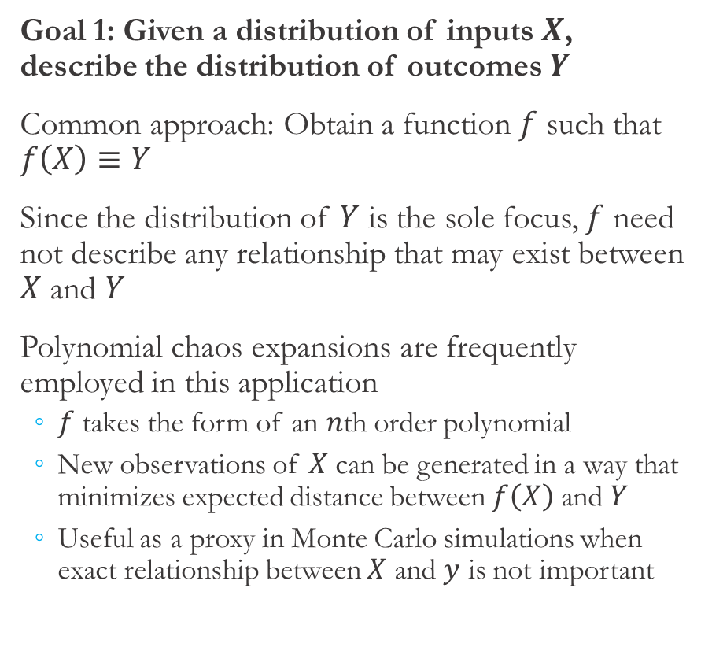
UQ Applications (1)
Goal 1: Given a distribution of inputs $X$, describe the distribution of outcomes $Y$
Common approach: Obtain a function $f$ such that $f\left(X\right)≡Y$
Since the distribution of $Y$ is the sole focus, $f$ need not describe any relationship that may exist between $X$ and $Y$
Polynomial chaos expansions are frequently employed in this application
$f$ takes the form of an $n$th order polynomial
New observations of $X$ can be generated in a way that minimizes expected distance between $f\left(X\right)$ and $Y$
Useful as a proxy in Monte Carlo simulations when exact relationship between $X$ and $y$ is not important

Slide 11
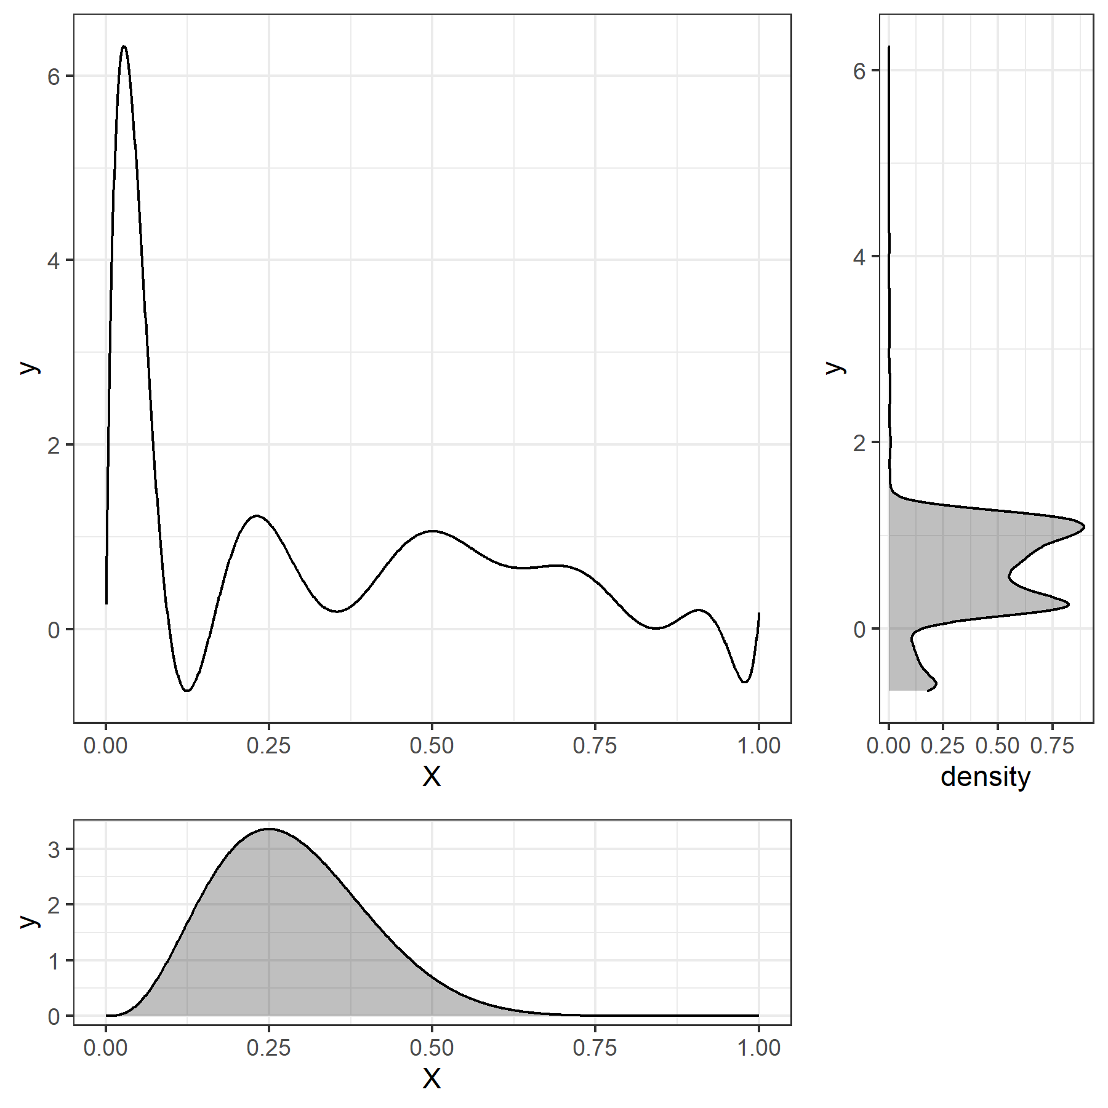
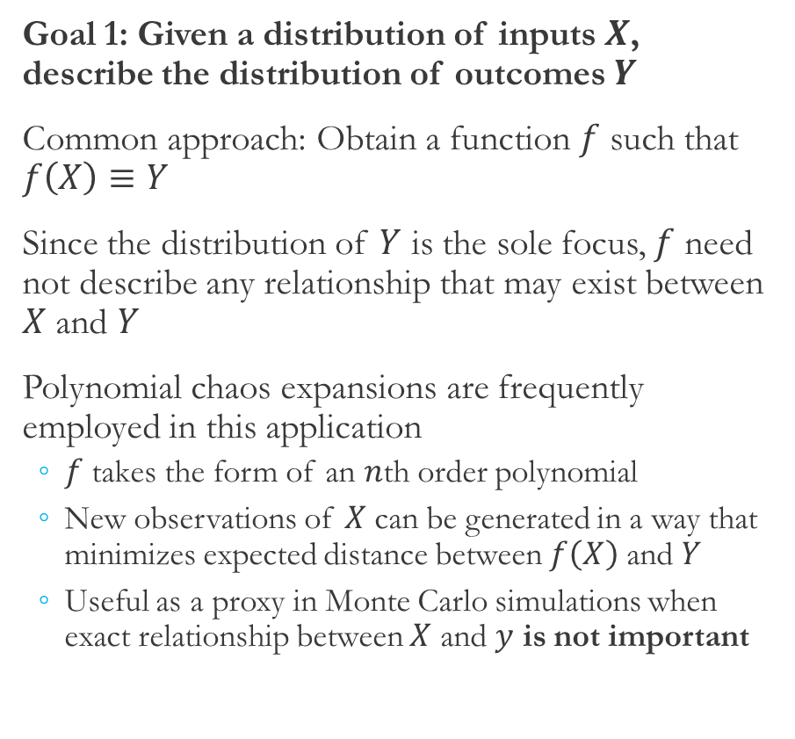
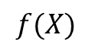
UQ Applications (1)
Goal 1: Given a distribution of inputs $X$, describe the distribution of outcomes $Y$
Common approach: Obtain a function $f$ such that $f\left(X\right)≡Y$
Since the distribution of $Y$ is the sole focus, $f$ need not describe any relationship that may exist between $X$ and $Y$
Polynomial chaos expansions are frequently employed in this application
$f$ takes the form of an $n$th order polynomial
New observations of $X$ can be generated in a way that minimizes expected distance between $f\left(X\right)$ and $Y$
Useful as a proxy in Monte Carlo simulations when exact relationship between $X$ and $y$ is not important
$$f(X)$$

Slide 12
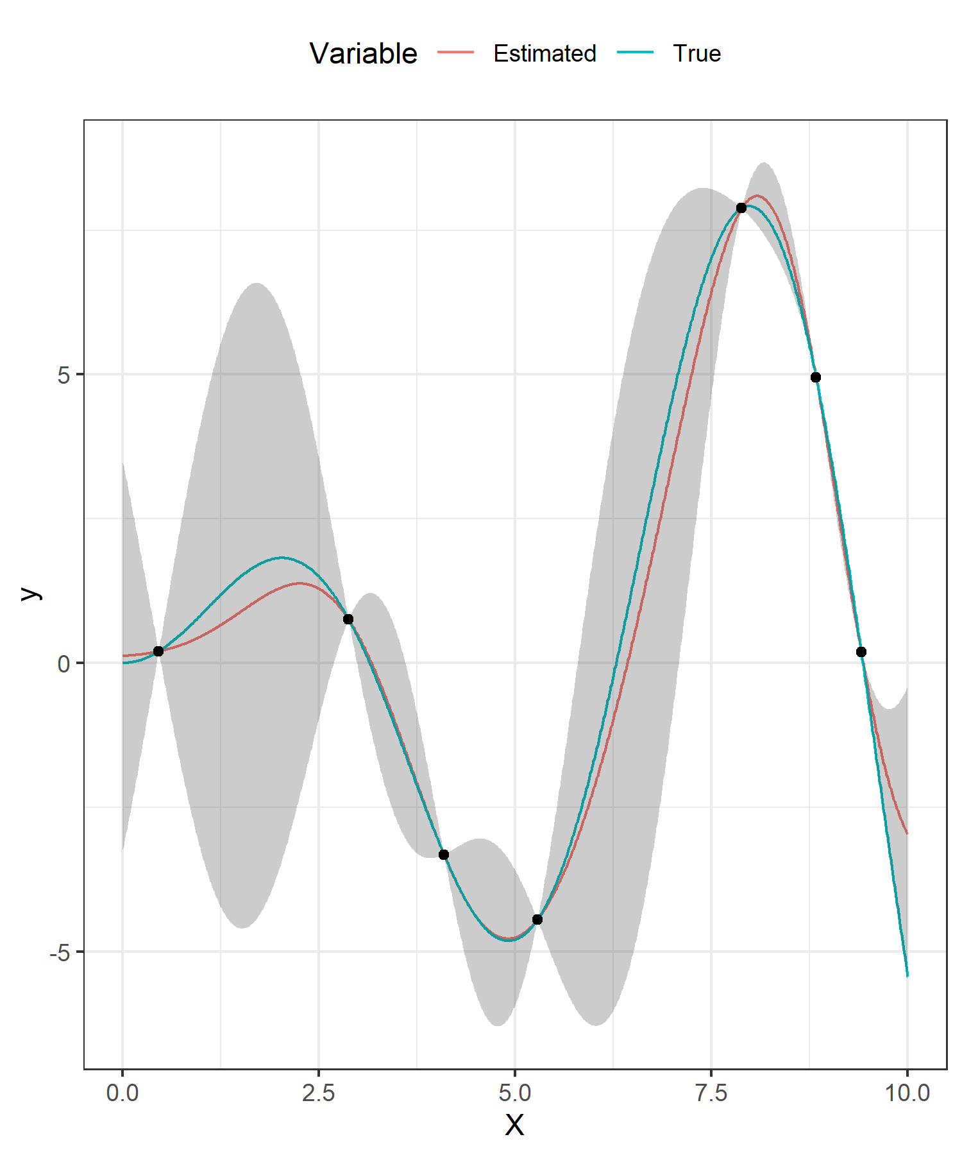
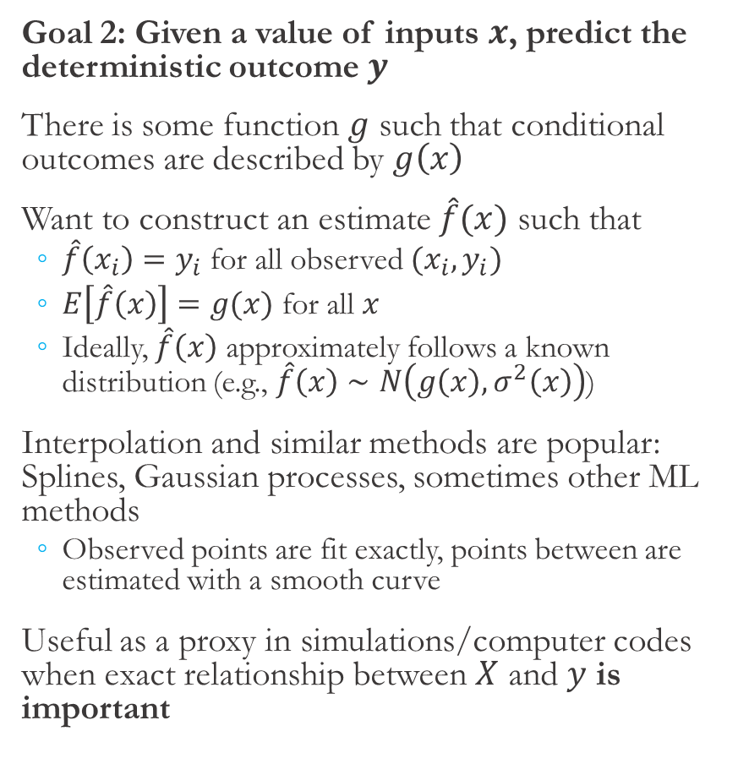
UQ Applications (2)
Goal 2: Given a value of inputs $x$, predict the deterministic outcome $y$
There is some function $g$ such that conditional outcomes are described by $g\left(x\right)$
Want to construct an estimate $\hat{f}(x)$ such that
$\hat{f}\left(x_{i}\right)=y_{i}$ for all observed $(x_{i},y_{i})$
$E\left[\hat{f}\left(x\right)\right]=g(x)$ for all $x$
Ideally, $\hat{f}\left(x\right)$ approximately follows a known distribution (e.g., $\hat{f}\left(x\right)∼N\left(g\left(x\right), σ^{2}\left(x\right)\right)$)
Interpolation and similar methods are popular: Splines, Gaussian processes, sometimes other ML methods
Observed points are fit exactly, points between are estimated with a smooth curve
Useful as a proxy in simulations/computer codes when exact relationship between $X$ and $y$ is important

Slide 13
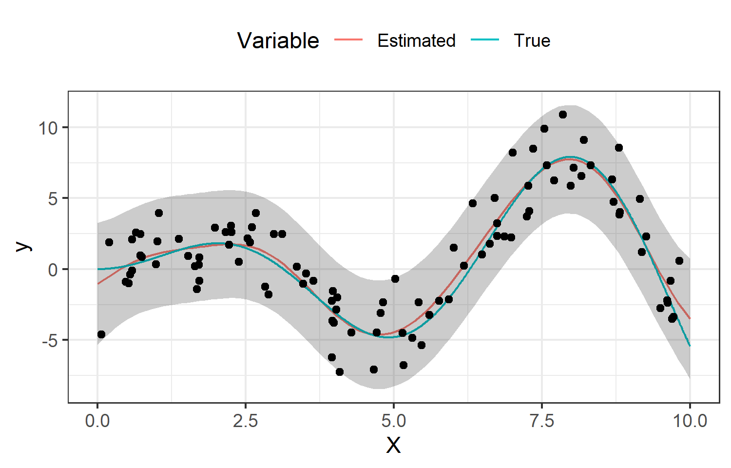
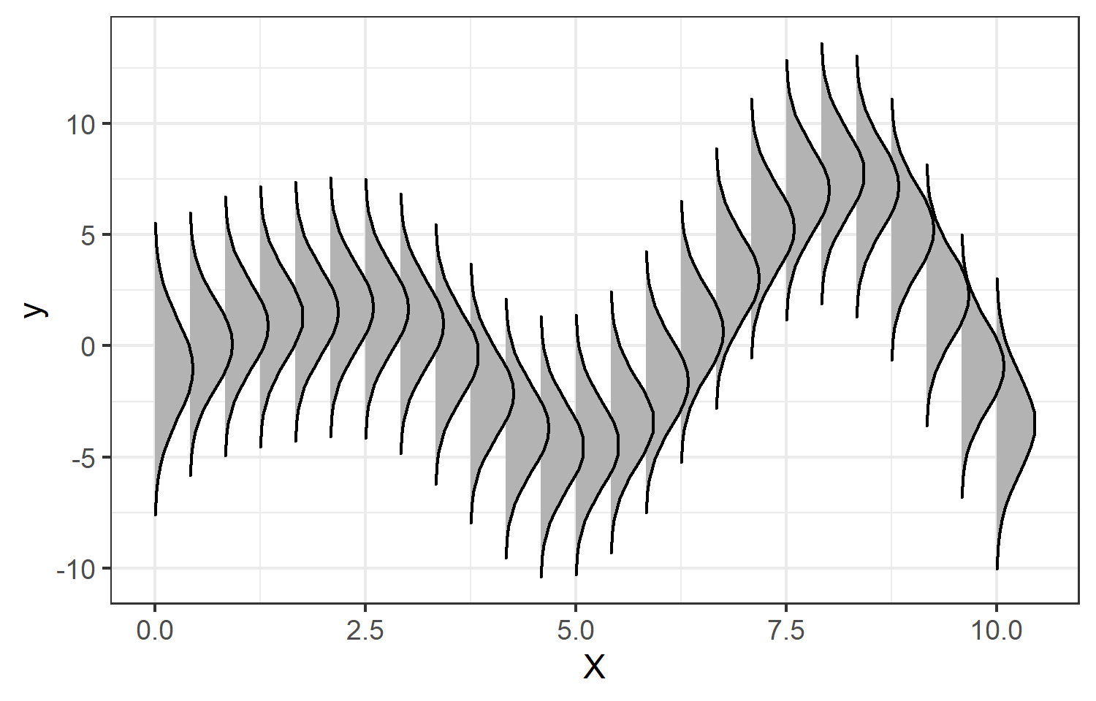
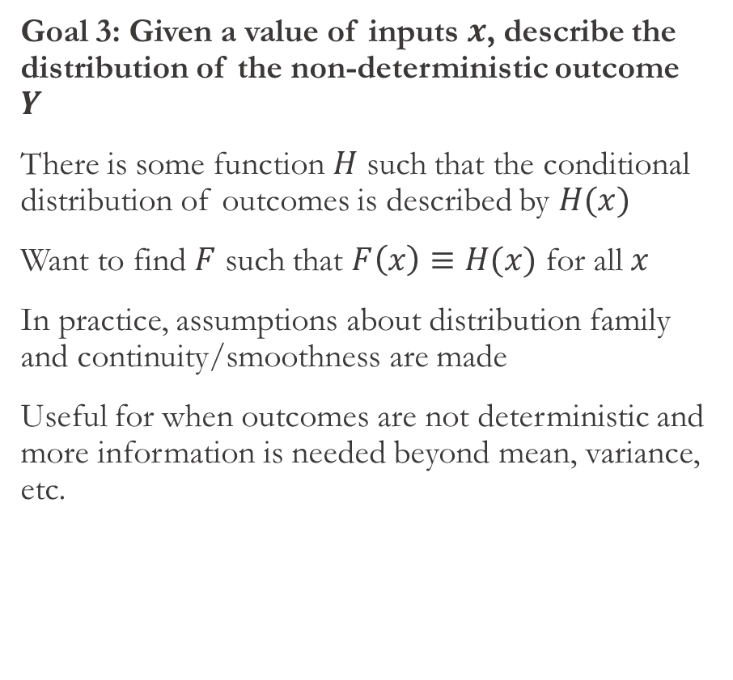
UQ Applications (3)
Goal 3: Given a value of inputs $x$, describe the distribution of the non-deterministic outcome $Y$
There is some function $H$ such that the conditional distribution of outcomes is described by $H(x)$
Want to find $F$ such that $F\left(x\right)≡H(x)$ for all $x$
In practice, assumptions about distribution family and continuity/smoothness are made
Useful for when outcomes are not deterministic and more information is needed beyond mean, variance, etc.

Slide 14
Research Objective and General Approach
Goal: Given a distribution of attacks, estimate the probability that differential pressure on the pressurizer will exceed 1 MPa
It would also be useful to identify attack scenarios in which risk is high and estimate distributions of outcomes under particular attack scenarios
Inputs to the emulation are components targeted (heater and/or sprayer) and values injected to targeted components. Output of emulation is indicator of whether differential pressure exceeded 1MPa at any point during the attack.
Notes:
Use this slide to explain why goal 3 is appropriate. Need to explain why it’s useful to have a continuum of distributions for this application.
Could also explain why GPs here…
Sneak peek into data could be useful here… Understand that inputs are distribution of values attacker is injecting to heater/sprayer and outcome is (uncertain) event that differential pressure exceeds 1 MPa given those value.
Goal 3 allows for identification of relationships between values injected and probability of consequence as well as overall understanding of probability of consequence.
Outcome is binary, and it’s not clear whether there is a simple/linear/monotonic relationship with outcome/odds. So, need some kind of nonlinear data-driven model; something like kernel smoothers are one appropriate approach.

Slide 15
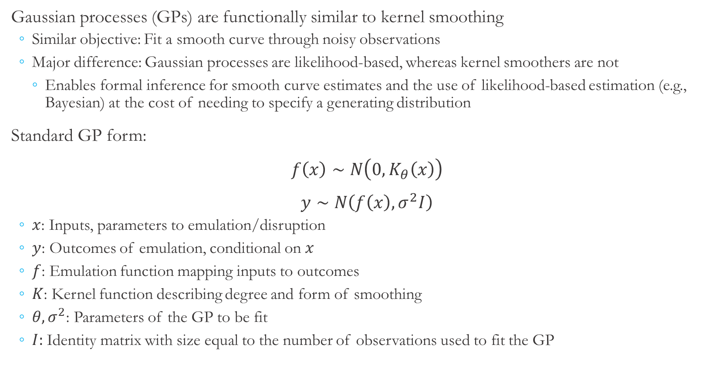
Gaussian Processes
Gaussian processes (GPs) are functionally similar to kernel smoothing
Similar objective: Fit a smooth curve through noisy observations
Major difference: Gaussian processes are likelihood-based, whereas kernel smoothers are not
Enables formal inference for smooth curve estimates and the use of likelihood-based estimation (e.g., Bayesian) at the cost of needing to specify a generating distribution
Standard GP form:
$f\left(x\right)∼N\left(0,K_{θ}\left(x\right)\right)$
$y∼N\left(f\left(x\right), σ^{2}I\right)$
$x$: Inputs, parameters to emulation/disruption
$y$: Outcomes of emulation, conditional on $x$
$f$: Emulation function mapping inputs to outcomes
$K$: Kernel function describing degree and form of smoothing
$θ,σ^{2}$: Parameters of the GP to be fit
$I:$ Identity matrix with size equal to the number of observations used to fit the GP
GP details
Notes:
Need some motivation somewhere (maybe not here) for using Bayesian/simulation methods. Difficulty of propagating uncertainty in parameter estimates to uncertainty in predictions. Parameter instability issues in generalized GPs like Bernoulli models (esp. applicable here). Assumptions for asymptotics are not necessarily met, issues with doing asymptotics with Bernoulli outcome.

Slide 16
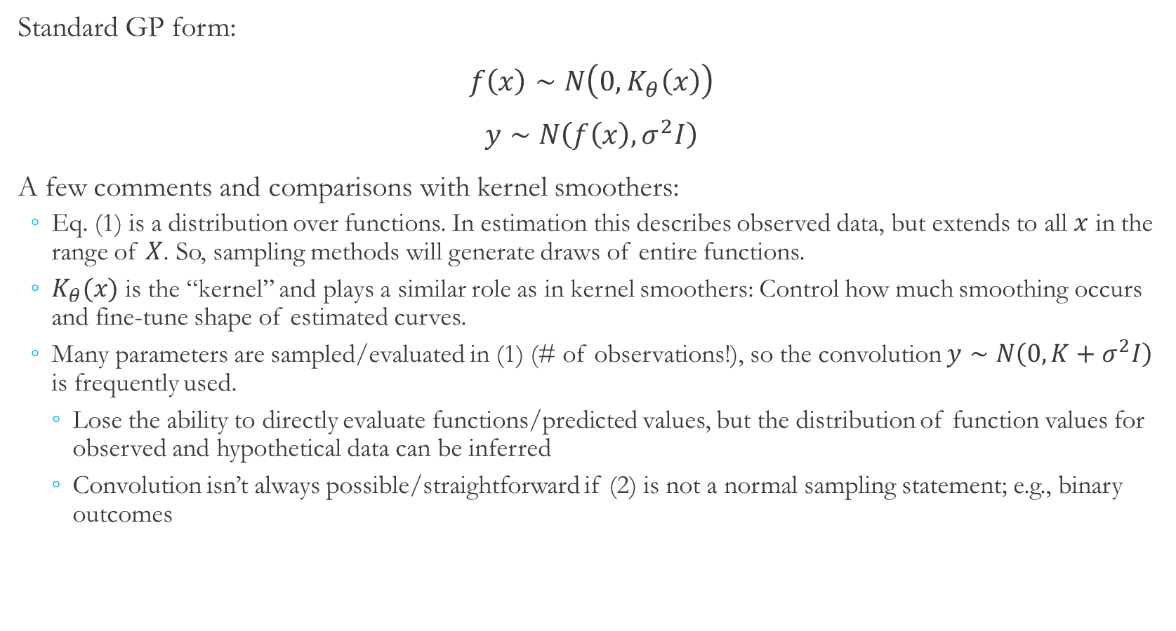
Gaussian Processes vs. Kernel Smoothers
Standard GP form:
$f\left(x\right)∼N\left(0,K_{θ}\left(x\right)\right)$
$y∼N\left(f\left(x\right), σ^{2}I\right)$
A few comments and comparisons with kernel smoothers:
Eq. (1) is a distribution over functions. In estimation this describes observed data, but extends to all $x$ in the range of $X$. So, sampling methods will generate draws of entire functions.
$K_{θ}(x)$ is the “kernel” and plays a similar role as in kernel smoothers: Control how much smoothing occurs and fine-tune shape of estimated curves.
Many parameters are sampled/evaluated in (1) (# of observations!), so the convolution $y∼N\left(0, K+σ^{2}I\right)$ is frequently used.
Lose the ability to directly evaluate functions/predicted values, but the distribution of function values for observed and hypothetical data can be inferred
Convolution isn’t always possible/straightforward if (2) is not a normal sampling statement; e.g., binary outcomes
(1)
(2)
GP details

Slide 17
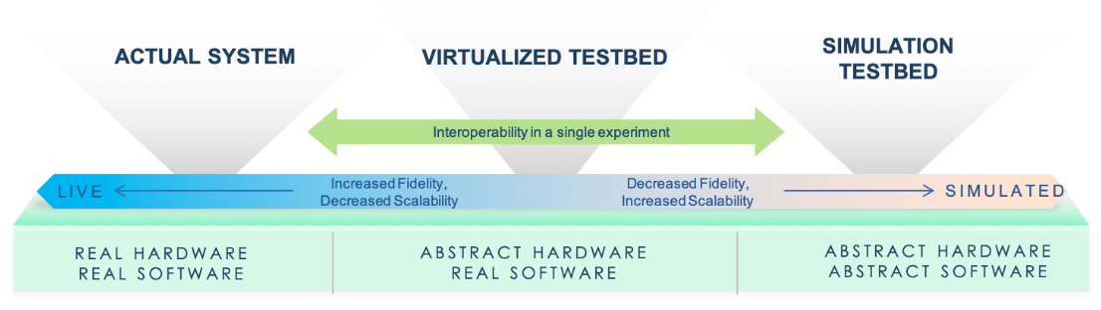
Emulation and Cyber Experiments
We want to evaluate how a critical system would respond to a given disruption
Quantify impacts
Identify and quantify effectiveness of mitigation strategies
Affecting operations of a critical system is infeasible
Emulation gives the ability to create a sufficient representation of a system, potentially including hardware in the loop
Emulation can be used to see how actual system would respond without affecting operations
Parameters of the system, emulation, or disruption may be uncertain
Thus, outcomes are also uncertain and can be described by a distribution
Uncertainty quantification (UQ) involves propagating input uncertainty to determine/approximate the distribution of outcomes
Notes:
In this research, we consider how a critical system would respond to a given disruption. This is a valuable exercise because it allows to determine what impacts a system might experience due to a disruption and investigate mitigation strategies.
Of course, since we’re considering a critical system, we can’t do anything that might affect operations of that system. We utilize emulation, which gives us the ability to create a sufficient representation of the system, potentially including hardware in the loop, that can be used to see how the actual system would respond without affecting operations.
When assessing impacts, we note that parameters of the system, emulation, or disruption may be uncertain. That uncertainty propagates through to outcomes, meaning impacts are also uncertain. Thus, our goal is to quantify the distribution of impacts given the distribution of inputs, which is an exercise in uncertainty quantification.
*****
This could be a good place to begin motivating (here’s why we use cyber experiments + emulation, here’s what output from emulation looks like and how its used, here’s why we need uncertainty quantification/continuous distribution/Bayesian methods. Show that each piece of the analysis was intentionally-driven.

Slide 18
Uncertainty Quantification With Surrogate Functions
Monte Carlo analysis can be used as a basic form of UQ
Draw sample of input parameters from specified distributions.
Evaluate emulation and store outcomes.
Repeat many times to approximate distributions of outcomes.
Cyber experiments are frequently computationally-intensive
It is often infeasible to evaluate emulation enough times to adequately approximate outcome distributions
Surrogate functions can be used to reduce computational burden at the cost of introducing uncertainty
Surrogate function process:
Emulation is evaluated a small (feasible) number of times over the parameter space.
A surrogate function mapping parameter space to outcome space is fit using evaluations from (1).
Generation of outcome distribution using the surrogate function from (2).
Notes:
Now, to give a commonly used example, Monte Carlo analysis is a basic form of UQ. In that procedure, a sample of inputs is drawn, the emulation is run and outcomes are collected, and the process is repeated many times to approximate outcome distributions.
As with many other applications, cyber experiments are often computationally-intensive, making it infeasible to evaluate the emulation enough times to adequately approximate outcome distributions.
In this case, surrogate functions are often used to reduce computational burden, at the cost of introducing some additional uncertainty.
The surrogate function process begins by evaluating the emulation a relatively small number of times across the parameter space. The surrogate function from the parameter space to the outcome space is then fit using those observations, and that surrogate function can then be used to generate predictions of outcome distribution more quickly than re-running the emulation.

Slide 19
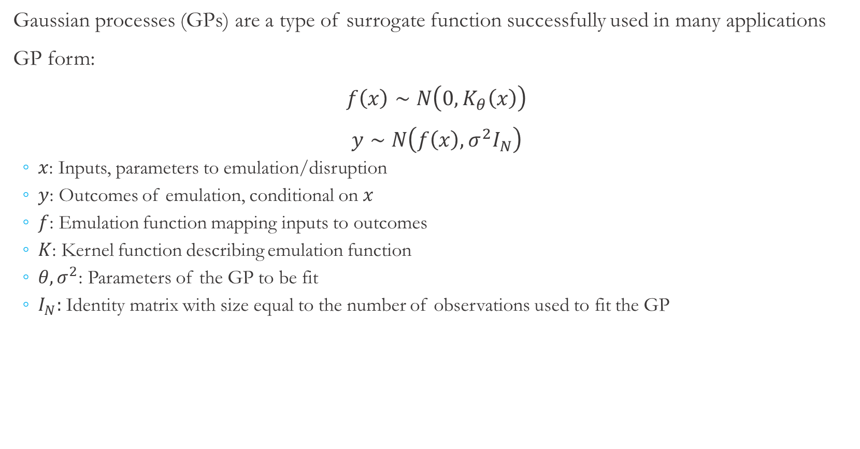
Gaussian Processes
Gaussian processes (GPs) are a type of surrogate function successfully used in many applications
GP form:
$f\left(x\right)∼N\left(0,K_{θ}\left(x\right)\right)$
$y∼N\left(f\left(x\right), σ^{2}I_{N}\right)$
$x$: Inputs, parameters to emulation/disruption
$y$: Outcomes of emulation, conditional on $x$
$f$: Emulation function mapping inputs to outcomes
$K$: Kernel function describing emulation function
$θ,σ^{2}$: Parameters of the GP to be fit
$I_{N}:$ Identity matrix with size equal to the number of observations used to fit the GP
Notes:
Gaussian processes are a type of surrogate function that have been successfully used in many applications. GPs have the shown form and provide structure for a distribution of functions from the input space to the outcome space.
Gaussian processes have some parameters that must be fit. Theta is an input to the kernel function that largely controls the degree of smoothing and sigma squared measures the variability of observed outcomes around predicted values.

Slide 20
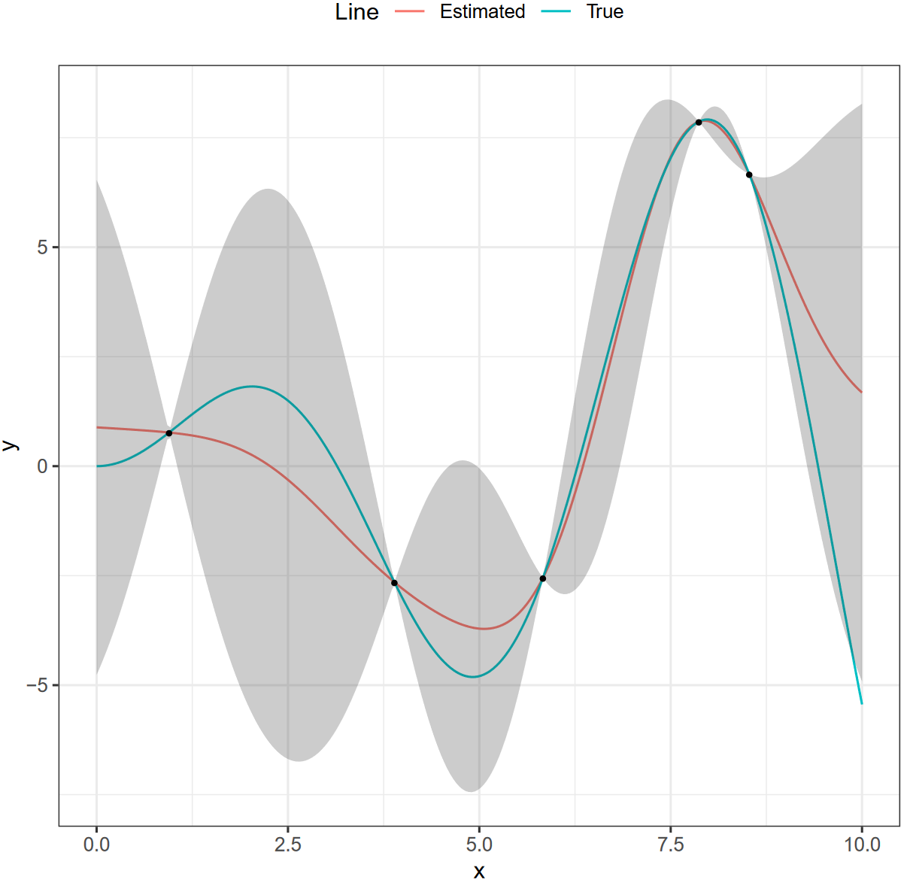
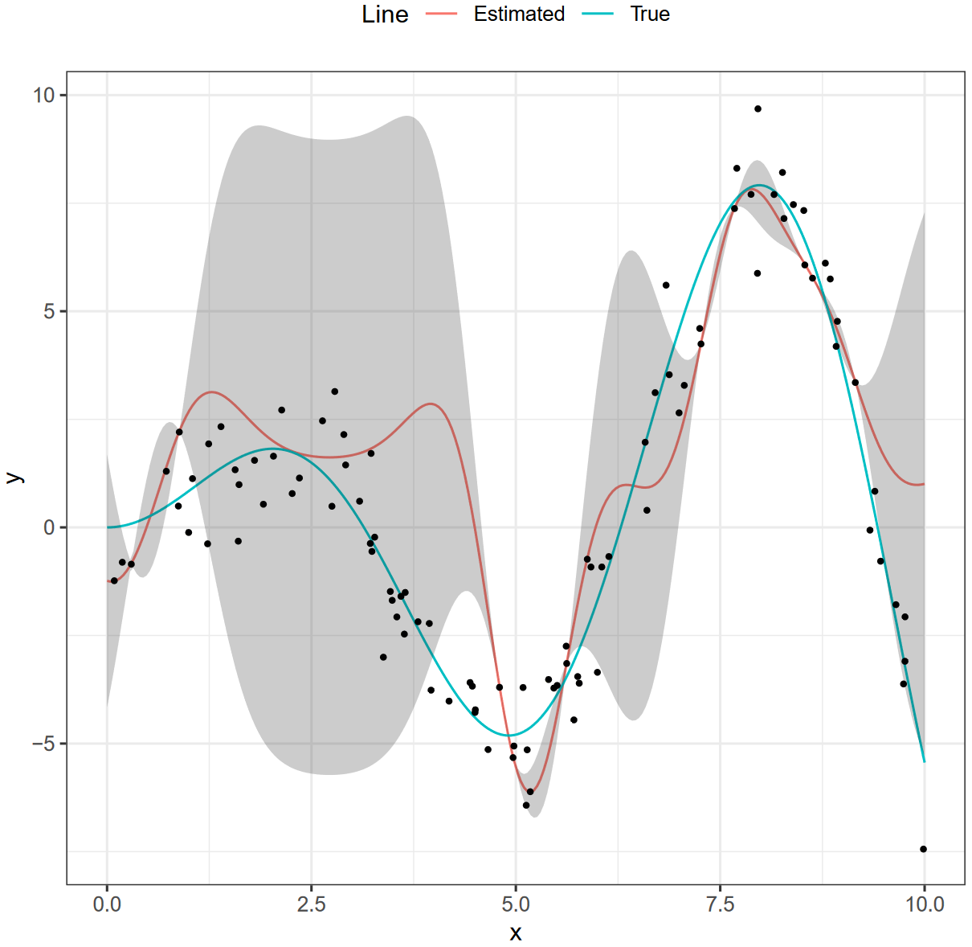
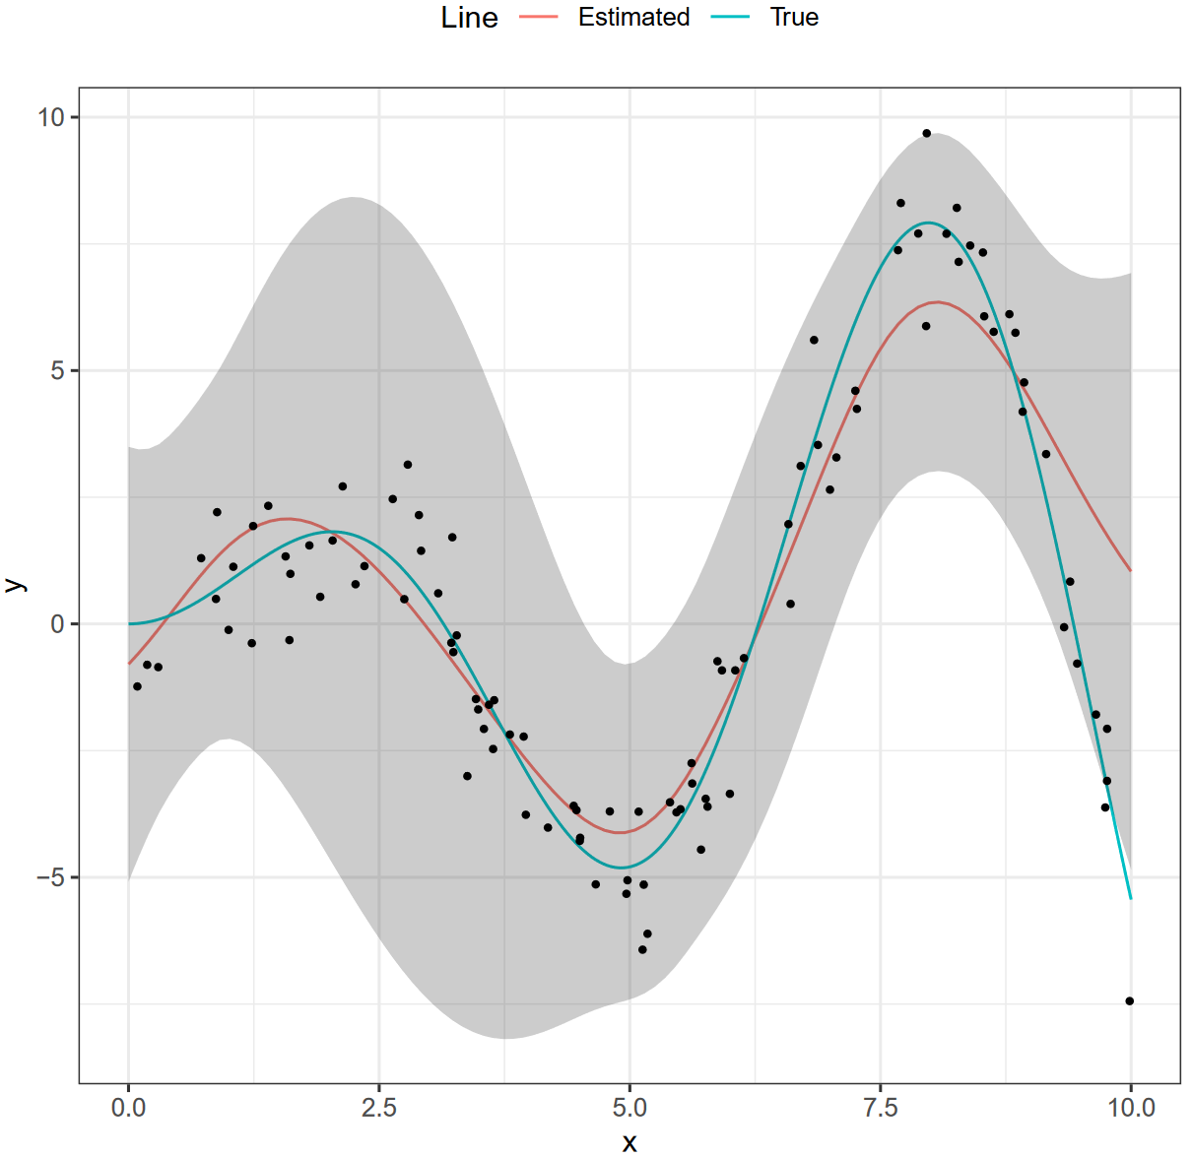
Gaussian Process Fits
Traditionally, parameters of GP are fit with maximum likelihood and then treated as certain. Observed outcomes are fit perfectly and intermediate points are uncertain.
Traditional framework does not accommodate any noise in outcomes and is therefore prone to overfitting in that case. Uncertainty in parameters is difficult to propagate because distribution of estimates are difficult to describe.
We utilize a Bayesian approach that specifies priors over GP parameters. Our procedure produces samples of parameters from their respective posterior distributions, allowing us to easily propagate parameter uncertainty through to outcomes.
Notes:
In the traditional framework, the parameters of a Gaussian process are fit using maximum likelihood. While there is uncertainty in those estimates, they are frequently treated as a single known point. Thus, observed outcomes are fit perfectly, and there is some uncertainty about intermediate points, as shown in the left figure.
Since observational noise contributes to parameter estimate uncertainty, the traditional framework cannot accommodate observational errors and is prone to overfitting in that case, as shown in the middle figure. The issue could be resolved by propagating uncertainty in parameter estimates through to outcomes, but that process can be difficult because the distribution of parameter estimates is difficult to describe.
By using a Bayesian approach, we are able to propagate parameter uncertainty in a robust and computationally-feasible way. This approach specifies priors over Gaussian process parameters, and is then able to produce samples directly from their respective posterior distributions, making uncertainty propagation more straightforward. Overall, this approach produces less biased estimates that properly capture uncertainty in the case where there is observational noise, as shown in the right figure.
We found that there is significant observational noise in our cyber-experiment outcomes, so it is crucial to use a method that accommodate those properties.

Slide 21
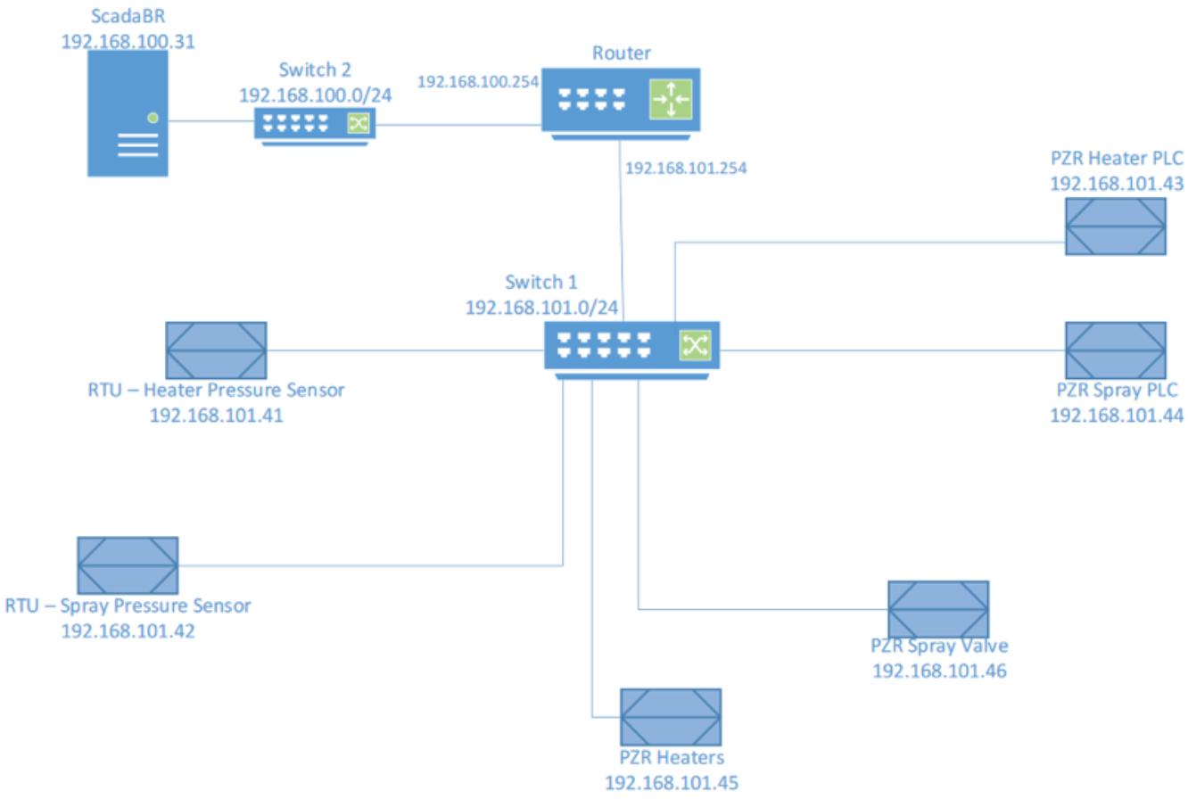
System and Emulation Description
We focus on a cyber-physical model of a PWR system
A numerical model (implemented in Simulink) describes the pressurizer and includes electric variable heaters, electric backup heaters, and a spray valve to dynamically control system pressure
An emulation-based model of cyber components (implemented in minimega, shown on right) contains virtual machines that implement a supervisory control and data acquisition (SCADA) server, a router, network switches, and remote terminal units and programmable logic controllers that sense pressure and actuate heater and/or sprayer
Notes:
Our system of interest is a cyber-physical model of a PWR system.
A numerical model, which is implemented in Simulink, describes the pressurizer and includes electric variable heaters, electric backup heaters, and a spray valve to dynamically control system pressure.
An emulation-based model of cyber components, which is implemented in minimega and shown on the right, contains virtual machines that implement a SCADA server, a router, network switches, and remote terminal units and programmable logic controllers that sense pressure and actuate the heater and/or sprayer.

Slide 22
Disruption, Quantities of Interest, and Sampling Procedure
Disruption:
An attacker targets either heater actuator, sprayer actuator, or both actuators, each with probability 1/3
The attacker continuously injects false values to targeted actuator(s) for two minutes. Injected values are constant over the attack and are assumed to be uniformly distributed over [0, 100]
Inputs to emulation: Which actuator is targeted, what values are injected to targeted actuator(s)
Severe consequences can occur if differential pressure of heater or sprayer exceeds 1 MPa
We focus on estimating probability that differential pressure will exceed 1 MPa at any point in the two minute attack, conditional on which actuator is targeted and values injected to targeted actuator(s)
Inputs used to fit the GP were generated with Latin hypercube sampling; emulation was run with those inputs and outcomes were recorded
Standard GP model was adapted to describe binary outcomes; GP was fit using the Stan platform, with 1000 warmup iterations and 1000 sampling iterations
Notes:
For the disruption, we assume an attacker has exploited a vulnerability in the system and targets either the heater actuator, sprayer actuators, or both actuators, each with probability 1/3. The attacker will then continuously inject false values to the targeted actuators for two minutes. The injected values are constant over the course of the attack and are distributed uniformly on the range from zero to 100.
Thus, the inputs to the emulation are which actuator is targeted and what values are injected to the targeted actuators.
Next, severe consequences can occur if differential pressure of the heater or sprayer exceeds one mega-Pascal.
We focus on estimating the probability that differential pressure will exceed one mega-Pascal at any point during the two minute attack, conditional on which actuator is targeted and values injected to the targeted actuators.
Inputs used to fit the Gaussian process were generated with Latin hypercube sampling, the emulation was run with those inputs, and outcomes were recorded to use in fitting the Gaussian process.
The standard Gaussian process model, which ordinarily describes real-valued outcomes, was adapted to describe binary outcomes. The Gaussian process was fit using the Stan platform, using 1000 warmup iterations and 1000 sampling iterations.

Slide 23
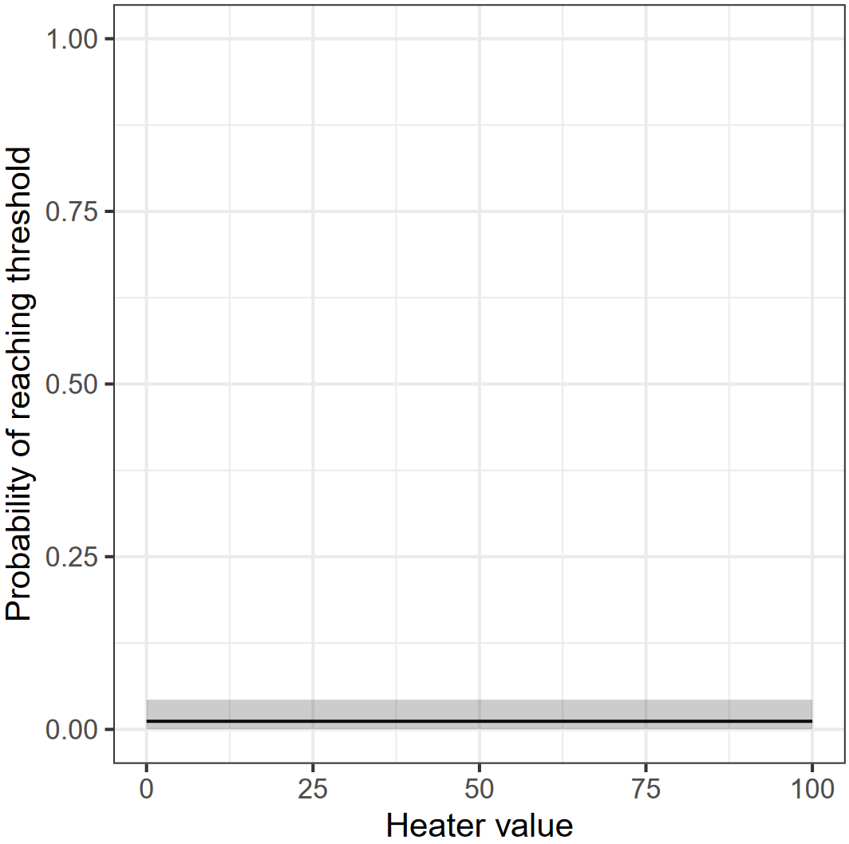
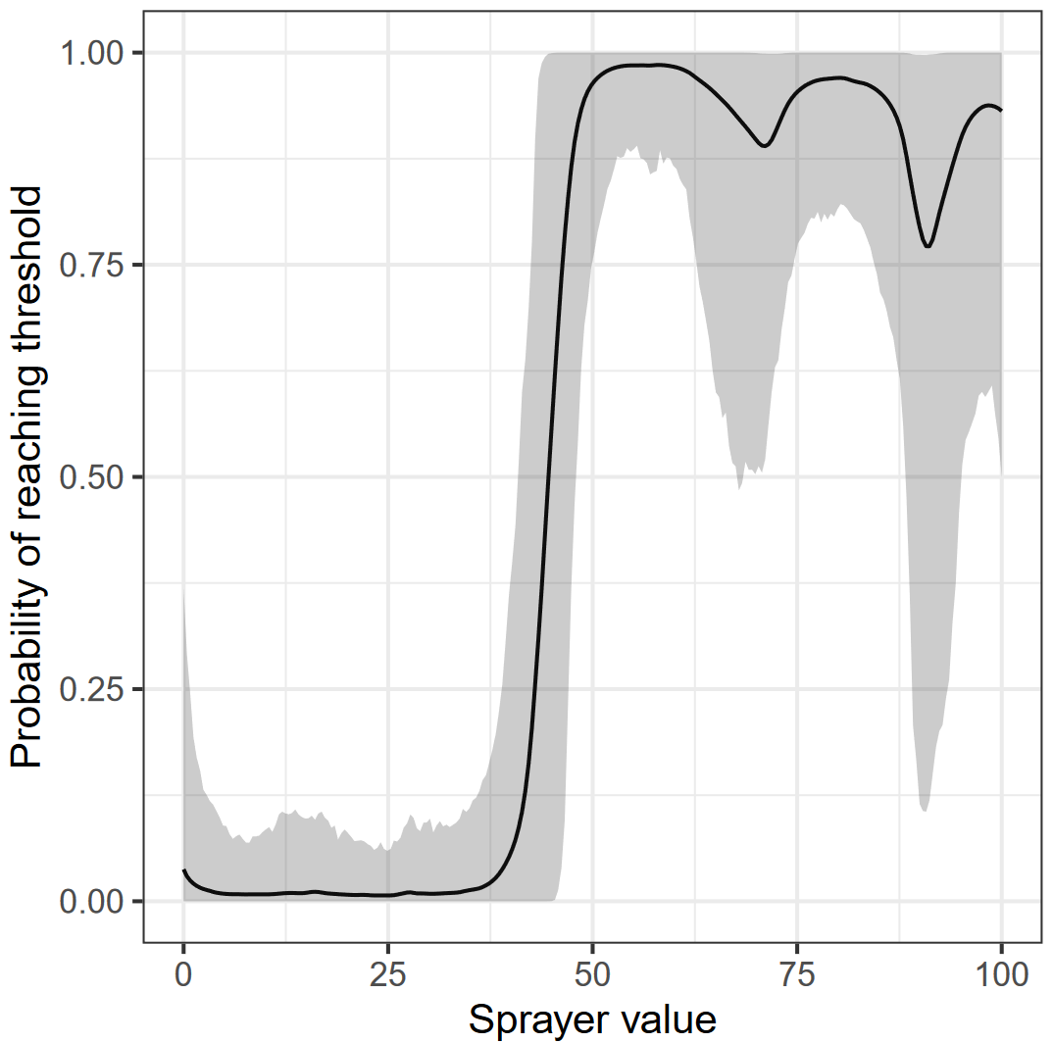
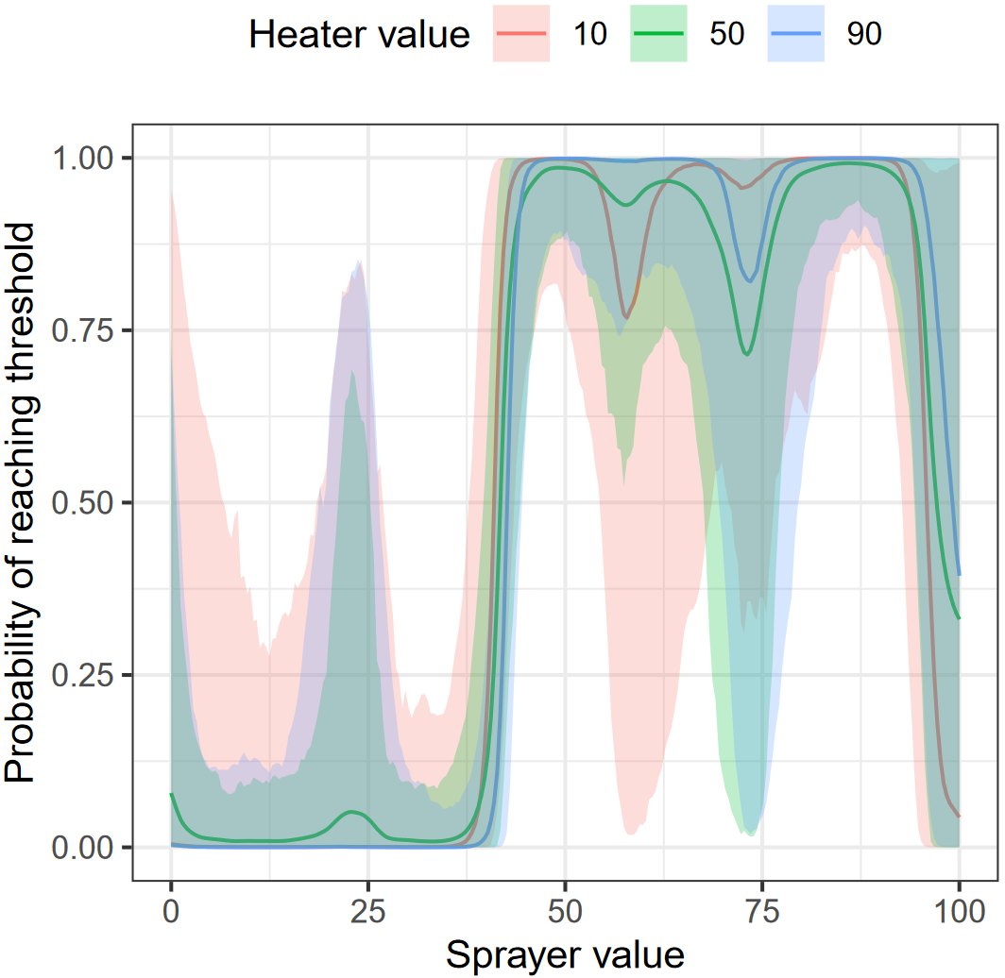
Conditional Probability Estimates
Probability of reaching 1 MPa threshold when only the heater actuator is targeted, conditional on values injected to heater actuator
Probability of reaching 1 MPa threshold when only the sprayer actuator is targeted, conditional on values injected to sprayer actuator
Probability of reaching 1 MPa threshold when both actuators are targeted, conditional on values injected to both actuators
Notes:
Next, we move to results. First, conditional probability estimates are shown on this slide. The left figure shows the probability of crossing the one mega-Pascal threshold if only the heater is targeted, middle shows if only sprayer is targeted, and right shows if both actuators are targeted. These figures begin to show some system behavior and avenues for possible mitigations. For example, it does not appear that the heater actuator plays a significant role, and the probability of crossing the threshold rises dramatically above sprayer values of about 40.
Bumps in the middle and right figure are due to iterations that did not result in crossing the one mega-Pascal threshold. These would indicate some overfitting, and we will discuss some ways to address in a couple slides.

Slide 24
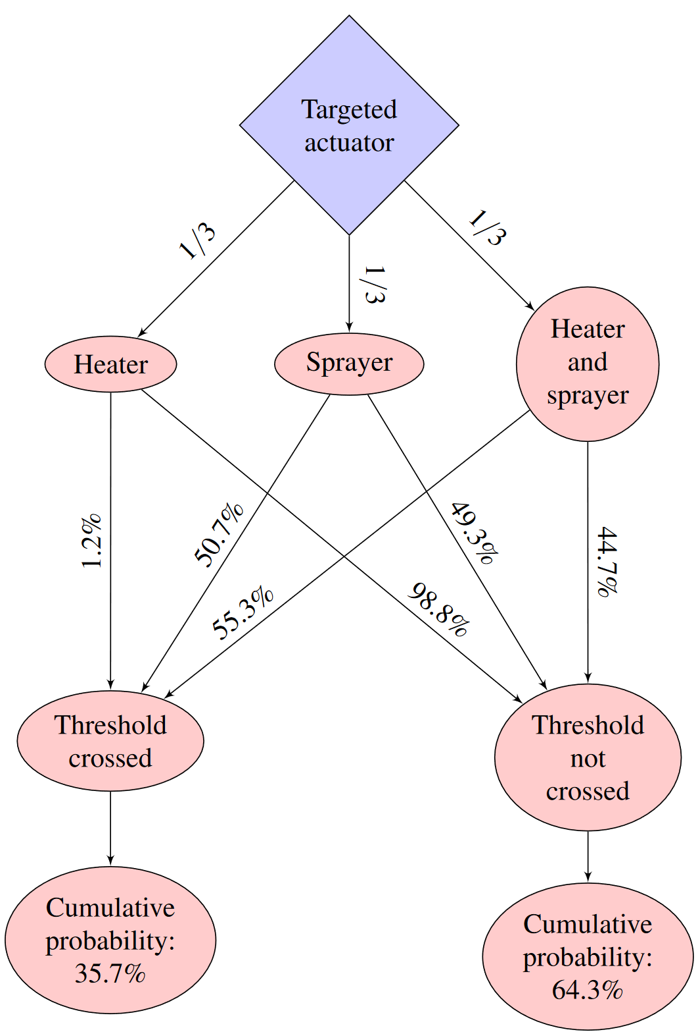
Overall Probability Estimates
Fitted GP surrogate function then used to estimate overall probability of crossing 1 MPa threshold
Heater actuator, sprayer actuator, and both actuators targeted with 1/3 probability each
Values injected to targeted actuator(s) uniformly distributed on [0, 100]
GP surrogate function provides computationally feasible method of approximating these probabilities
Each iteration of the emulation takes 5 minutes to set up/stabilize + 2 minutes for attack
Each sample of the GP takes ~0.7 seconds (3.5 GHz processor)
Notes:
We can also use the fitted Gaussian process surrogate function to estimate the overall probability of cross the one mega-Pascal threshold. Recall that the heater actuator, sprayer actuator, and both actuators are each targeted with probability 1/3, and values injected to targeted actuators are uniformly distributed on the interval from 0 to 100. The event tree and results are shown in the figure on the right. Overall, given assumptions about the attack, we estimate there is a 35.7% probability the threshold will be crossed given the attack occurs.
Using a Gaussian process surrogate function makes it computationally feasible to approximate these probabilities. To illustrate, each iteration of the emulation takes five minutes to set up and stabilize and an additional two minutes for the attack.
On the other hand, each sample of the Gaussian process takes about 0.7 seconds.

Slide 25
Extensions
Investigation of alternative surrogate functions, including goodness-of-fit measures
Alternative forms of GP model
Imposition of constraints such as monotonicity
Alternative correlation structure in outcomes; e.g., relationship between outcomes when only sprayer actuator is targeted vs. when both actuators are targeted
Alternative sampling methodologies to boost efficiency of surrogate functions
Extension to real-valued outcomes
Preliminary results indicate some outcomes may be distinctly non-normal and standard methods may not apply
Notes:
While this research illustrates one method to perform uncertainty quantification on a cyber experiment with noisy outcomes, there are several extensions that could be pursued.
First, this research only considers a Gaussian process surrogate function. There are many other choices of surrogate functions available that one could compare with, for example, goodness-of-fit metrics.
There are also alternative forms of the Gaussian process model that could be considered. Additional constraints like monotonicity could be imposed, and alternative correlation structures could be explored.
While this research used Latin hypercube sampling to generate data to fit the surrogate function, other sampling methodologies could yield greater efficiency.
Finally, this research focused on a binary outcome but could also be used to describe real-valued outcomes. Our preliminary results indicate some outcomes may be distinctly non-normal (such as Cauchy distribution), so standard methods may need to be adjusted to be applicable.

Slide 26
Acknowledgements
Thanks to Eric Vugrin, Robert Bruneau, Meg Galiardi, Amanda Gonzales, Jamie Thorpe, Ray Fasano, Tim Ortiz, and Ryan Kao
Work made possible by funding from DOE-NE Cyber Security for Nuclear Facilities
Notes:
We would like to thank Eric Vugrin and Robert for their leadership and thoughtful suggestions, Meg Galiardi, Amanda Gonzales, and Jamie Thorpe for their help with our UQ experiments, Ray Fasano for the PWR Simulink model and model description, and Tim Ortiz and Ryan Kao for the minimega model of the cyber system.
Finally, this work was made possible by funding from DOE-NE Cyber Security for Nuclear Facilities.

Slide 27
References
[1] SCEPTRE one-pager

Slide 28
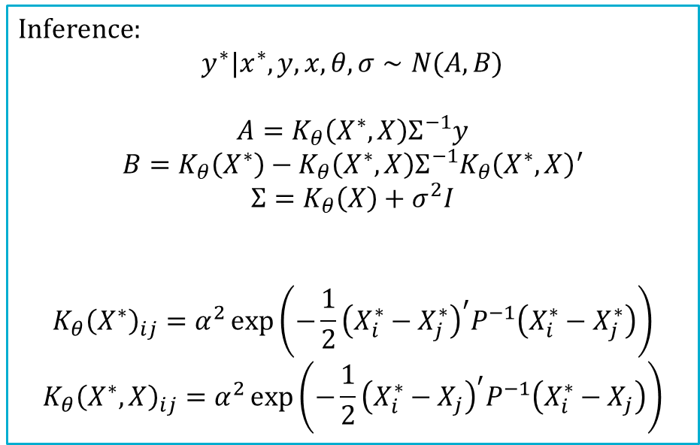
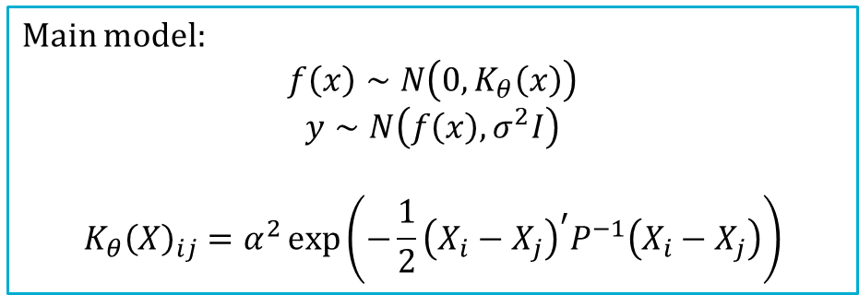

Gaussian Process Details
Main model:
$$f\left(x\right)∼N\left(0,K_{θ}\left(x\right)\right)$$
$$y∼N\left(f\left(x\right), σ^{2}I\right)$$
$$K_{θ}{\left(X\right)}_{ij}=α^{2}\exp\left(−\frac{1}{2}{\left(X_{i}−X_{j}\right)}^{′}P^{−1}\left(X_{i}−X_{j}\right)\right)$$
Inference:
$$y^{∗}|x^{∗},y,x,θ,σ∼N(A, B)$$
$$A=K_{θ}\left(X^{∗},X\right)Σ^{−1}y$$
$$B=K_{θ}\left(X^{∗}\right)−K_{θ}\left(X^{∗}, X\right)Σ^{−1}K_{θ}{\left(X^{∗}, X\right)}^{′}$$
$$Σ=K_{θ}\left(X\right)+σ^{2}I$$
$$K_{θ}{\left(X^{∗}\right)}_{ij}=α^{2}\exp\left(−\frac{1}{2}{\left(X_{i}^{∗}−X_{j}^{∗}\right)}^{′}P^{−1}\left(X_{i}^{∗}−X_{j}^{∗}\right)\right)$$
$$K_{θ}{\left(X^{∗},X\right)}_{ij}=α^{2}\exp\left(−\frac{1}{2}{\left(X_{i}^{∗}−X_{j}\right)}^{′}P^{−1}\left(X_{i}^{∗}−X_{j}\right)\right)$$
(1)
(2)
Dimension reduction using convolution:
(1) + (2) $⇒$
$$y∼N\left(0, K_{θ}(x)+σ^{2}I\right)$$
Return to main presentation

Slide 29
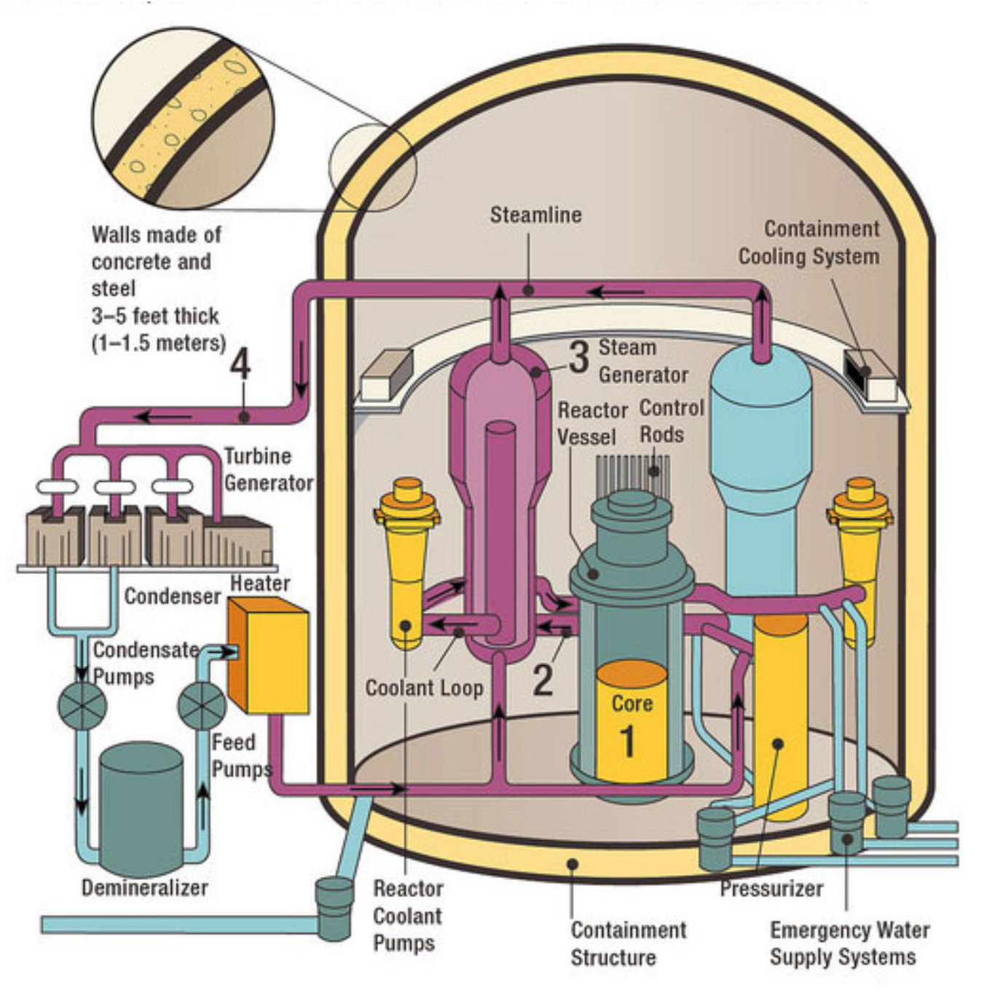
Proof of Concept System: Pressurized Water Reactor (PWR)
Image source: NRC

